Slide 1
Risk and Return and Preference Shares
Attendance: 225290
Week 8

Slide 2
Retained Earnings
Another form of equity- large source of capital
Part of the profit not distributed to shareholders
Advantages
No dilution to existing shareholders
No issuance costs
Disadvantages
Limited to profits
Reduce dividends
Uncertain
Managers may regard them as “free capital”

Slide 3
Preference Shares
Preference shareholders are senior to ordinary
Receive dividend 1st
Get their money back 1st if something goes wrong (but only after debtholders)
Normally offer their owners a fixed rate of dividend each year.
Managers can decide against the dividend
Preference shares are part of shareholders’ funds but
Not usually able to benefit from any extraordinarily good performance of the firm
Usually carry no voting rights.

Slide 4
From the firm point of view: Equity vs Debt
Advantages of Debt
Equity is more expensive
Less risk of loss of control
Interest is tax deductible
Disadvantages of Debt
Obligation to pay interest
Obligation to repay equity capital
Creditors often require that the loan is secured against some asset(s) of the business

Slide 5
Cash Returns
If you invest on a financial asset your gain (or loss) is called a return
Returns (can) have 2 components
Current income (e.g. coupons)
Capital gains (losses)- change in value
Total Cash return (share)= Dividend + capital Gains (loss)

Slide 6
Percentage returns
A cash return doesn’t tell investors how good the return is in relation to the amount invested
A percentage return is the cash return as a proportion of the total investment
The percentage return is the Holding period return

Slide 7
Suppose you bought 1 share 1 year ago for 120p ; you just got a dividend of 10p and the share is now worth 125p. The cash and percentage returns are:

Slide 8
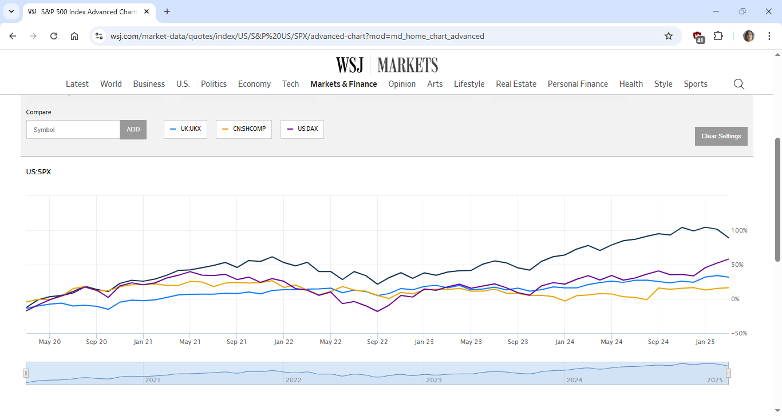
Historical Returns

Slide 9
Historical returns
If we want to assess the stock market return which measure should we use?
instead of concentrating in a single year we would like to have a measure which could tell us what a typical year looks like

Slide 10
Average returns
A good indicator of asset or market performance is the historic average return. Over the last 20 years what was the average market return?

Slide 11
Geometric returns
Average returns as calculated before are arithmetic (simple) averages.
What we get on a typical year
Geometric averages- the average compound return earned per year
What we get EXACTLY on an average year
We tend to use Arithmetic when we are forecasting expected returns (if nothing is said assume arithmetic)

Slide 12
Geometric returns
Suppose you bought a share two years ago for 150p. At the end of the 1st year the share was worth 100p and it is now worth 150p. What was the annual average return in arithmetic terms? In Geometric terms?

Slide 13
More on Average Returns
Blume’s Formula
Although we tend to use arithmetic averages when we are forecasting we know that averages are biased:
Arithmetic averages tend to be too large for long periods
Geometric averages tend to be too low for smaller periods
From 25 years of annual returns data, we calculate an arithmetic average return of 12 per cent and a geometric average return of 9 per cent. What are the 1-year, 5-year and 10-year annual average return forecasts?
N is Number of observations
Ta is the number of periods we are forecasting for

Slide 14
Risk Premium
On average investors in large stocks got from 2002 to 2022 a yearly return of 4.15% and in smaller stocks 9.47%- was this good?
How do these returns compare to returns of investments with no risk?
FTSE 100 (2002-2022) | FTSE small (2002-2022)
4.15% | 9.47%

Slide 15
Risk Premium
An example of an (almost) risk free investment are Treasury bills
T-bills- have short maturities and are issued by the government (to be precise risk free investments don’t exist)
We will call risk free return to the return of a risk free investment (Rf)

Slide 16
Risk Premium
Risk premium: the difference between the return of a risky investment and the risk free.
Suppose the risk free return from was 1% (the overall market return over the same period are below). What is the risk premium on the market indexes
FTSE 100 (2002-2022) | FTSE small (2002-2022)
4.15% | 9.47%

Slide 17
The risk Premium
The risk premium for FTSE small is larger.
Smaller and medium size companies are riskier and thus investors demand compensation to bear more risk
The higher the risk premium the higher the risk!

Slide 18
Which is riskier?

Slide 19
Variability of returns
In finance measures of risk are measures of variability (dispersion). To measure risk we will measure the spread of the returns
Variance Average value of squared deviations from mean. A measure of volatility.
Standard deviation Square root of variance. Another measure of volatility.
More variable returns imply greater investment risk.
This gives an idea of how much the returns deviate from their average in a typical year

Slide 20
Past Returns and past Risk
What was the standard deviation of the annual returns below?
Year | Rate of return (%)
1 | 31.29
2 | 23.43
3 | 23.56
4 | -10.89
5 | -10.97

Slide 21
Measuring past Risk

Slide 22
Example (past returns)
Year | Rate of return (%) | Deviation from average Return (%) | Squared deviation
1 | 31.29
2 | 23.43
3 | 23.56
4 | -10.89
5 | -10.97
Total | 56.42

Slide 23
Example (past returns)
Year | Rate of return (%)
1 | 31.29
2 | 23.43
3 | 23.56
4 | -10.89
5 | -10.97
Total | 56.42
Deviation from average Return (%)
31.29-11.28=20.01
23.43-11.28=12.15
12.28
-22.17
-22.25

Slide 24
Example (past returns)
Year | Rate of return (%)
1 | 31.29
2 | 23.43
3 | 23.56
4 | -10.89
5 | -10.97
Total | 56.42
Deviation from average Return (%)
31.29-11.28=20.01
23.43-11.28=12.15
12.28
-22.17
-22.25
Squared deviation
20.01^2=400.40
12.15^2=147.62
150.80
491.51
495.06
1685.39

Slide 25
How to interpret these figures?

Slide 26
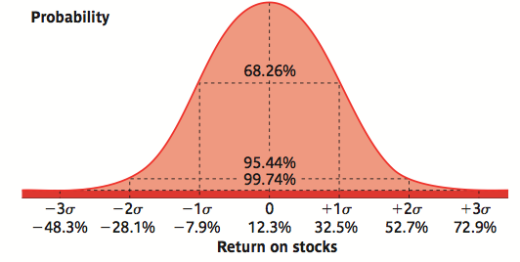
Risk Statistics
What Does Variance and Standard Deviation Signify?
The normal distribution is symmetric around the mean
The probability of having a return above or below the mean by a certain amount depends on the standard deviation

Slide 27
Mean+/-Standard deviation
-9.247=11.28-20.527
31.807=11.28+20.527
There is a 68.26% probability that the return will be between -9.247% and 31.807%

Slide 28
Expected returns and risk
What if we want to calculated expected (future average) returns and expected risk?
Commonly investors take the past risk and return and assume this is a good predictor of the future (expected)
Sometimes investors are able to get to more accurate estimations of (possible) future returns and to associate probabilities to these

Slide 29
Expected Risk and Return
Suppose there are 3 equally likely scenarios for the economy: a recession, normal growth and a boom. The rate of return of 2 shares in each of the states of the economy is expected to be:
Scenario | Probability | Auto Stock (%) | Gold Stock (%)
Recession | 1/3 | 1 | 20
Normal | 1/3 | 3 | 10
Boom | 1/3 | 4 | -20
1st calculate the average return- i.e. the expected return

Slide 30
Scenario | Probability | Auto Stock (%) | Gold Stock (%)
Recession | 1/3 | 1 | 20
Normal | 1/3 | 3 | 10
Boom | 1/3 | 4 | -20

Slide 31
Standard deviation
2nd - calculate the deviation from the average
Auto Stock
Scenario | Rate of Return (%)
Recession | 1
Normal | 3
Boom | 4
Deviation from Expected Return (%)
1-2.667=-1.667
3-2.667=0.333
4-2.667=1.333

Slide 32
Standard deviation
2nd - calculate the deviation from the average
Auto Stock
Scenario | Rate of Return (%)
Recession | 1
Normal | 3
Boom | 4
Deviation from Expected Return (%)
1-2.667=-1.667
3-2.667=0.333
4-2.667=1.333
Squared Deviation * Prob
(-1.667)^2*1/3=0.926
0.037
0.592

Slide 33
Scenario | Auto Stock (%) | Gold Stock (%)
E[return] | 2.67 | 3.33
Risk | 1.25 | 17.00
What is the relation between risk and return?
Why is Gold Stock Riskier?
Which one would YOU buy?

Slide 34
Risk Attitudes
Risk Averse
Risk Seeker
Risk Neutral

Slide 35
Other Risk Measures-Downside Risk
Investors associate risk with “bad” outcomes such as negative returns or returns below expectations. They do not associate risk with large (+) returns or upswings.
Measures of downside risk can be used to estimate required returns and risk-adjusted returns, making them useful to portfolio managers and investors.
*Measuring volatility below a specified benchmark is possible using the “downside standard deviation,” also known as “semi-deviation,” with respect to benchmark

Slide 36
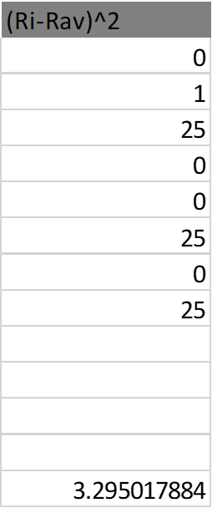
Example in which investors’ target is the historical average of returns
Semi deviation

Slide 37
Extra material

Slide 38
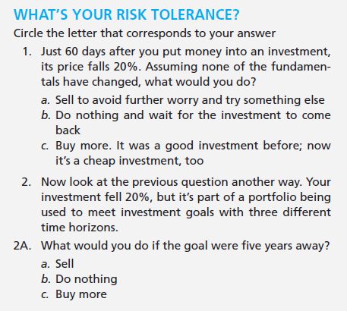
Estimating Risk Aversion

Slide 39
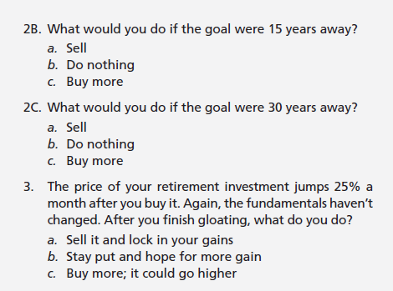
Estimating Risk Aversion

Slide 40
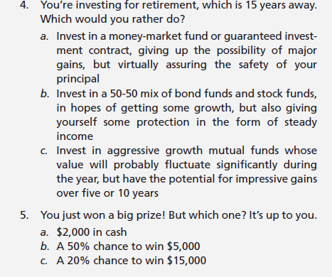
Estimating Risk Aversion

Slide 41
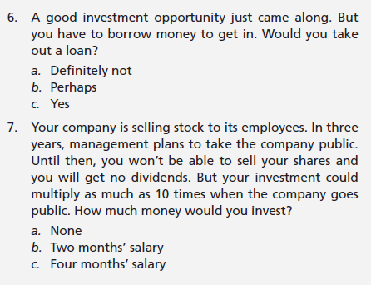
Estimating Risk Aversion

Slide 42
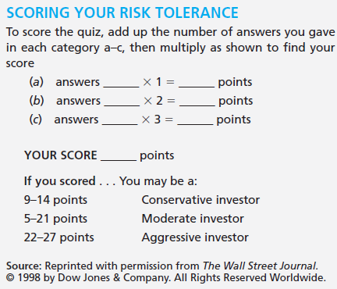
Estimating Risk Aversion

Slide 43
Standard Deviation for Gold
Gold Stock
Rate of Return (%) | Deviation from Expected Return (%) | Squared Deviation* Prob
20 | 16.667 | 92.596
10 | 6.667 | 14.82
-20 | -23.333 | 181.476

